Slide 1
Hackapizza 2025
Team - LSF

Slide 2
Summary
Problem Description
Solution Description
Design Principles
High Level Architecture
Offline Phase: Knowledge Base Creation
Online Phase: Knowledge Base Querying
Results & Improvements

Slide 3
Problem Description
Goal: develop a “intergalactic food advisor” that can provide the user with a list of suitable dishes based on a question in natural language, which implicitly contains some constraints.
Basic Setting: in the galaxy there are 30 different restaurants scattered around 10 different planets, each with its chef and its unique set of dishes (i.e., menu). Every chef has their own cooking licenses, and every dish is prepared with specific ingredients and cooking techniques.
Additional Info: every cooking technique requires a set of licenses to be performed, some ingredients that contain weird substances cannot exceed a certain thresholds, and there are three different orders to take care of.

Slide 4
Solution Description – Design Principles
Make the System as Predictable and Controllable as Possible.
Combine LLMs with Rule-Based Parsing.
Map Questions to Predefined Sequences of Actions.
Make the System Deployable On-Premises with Limited Resources.
Use “Small“ Open Weights Large Language Models (LLMs).
Focus on Data Quality.
Define a Precise Data Model that Suits the Application.

Slide 5
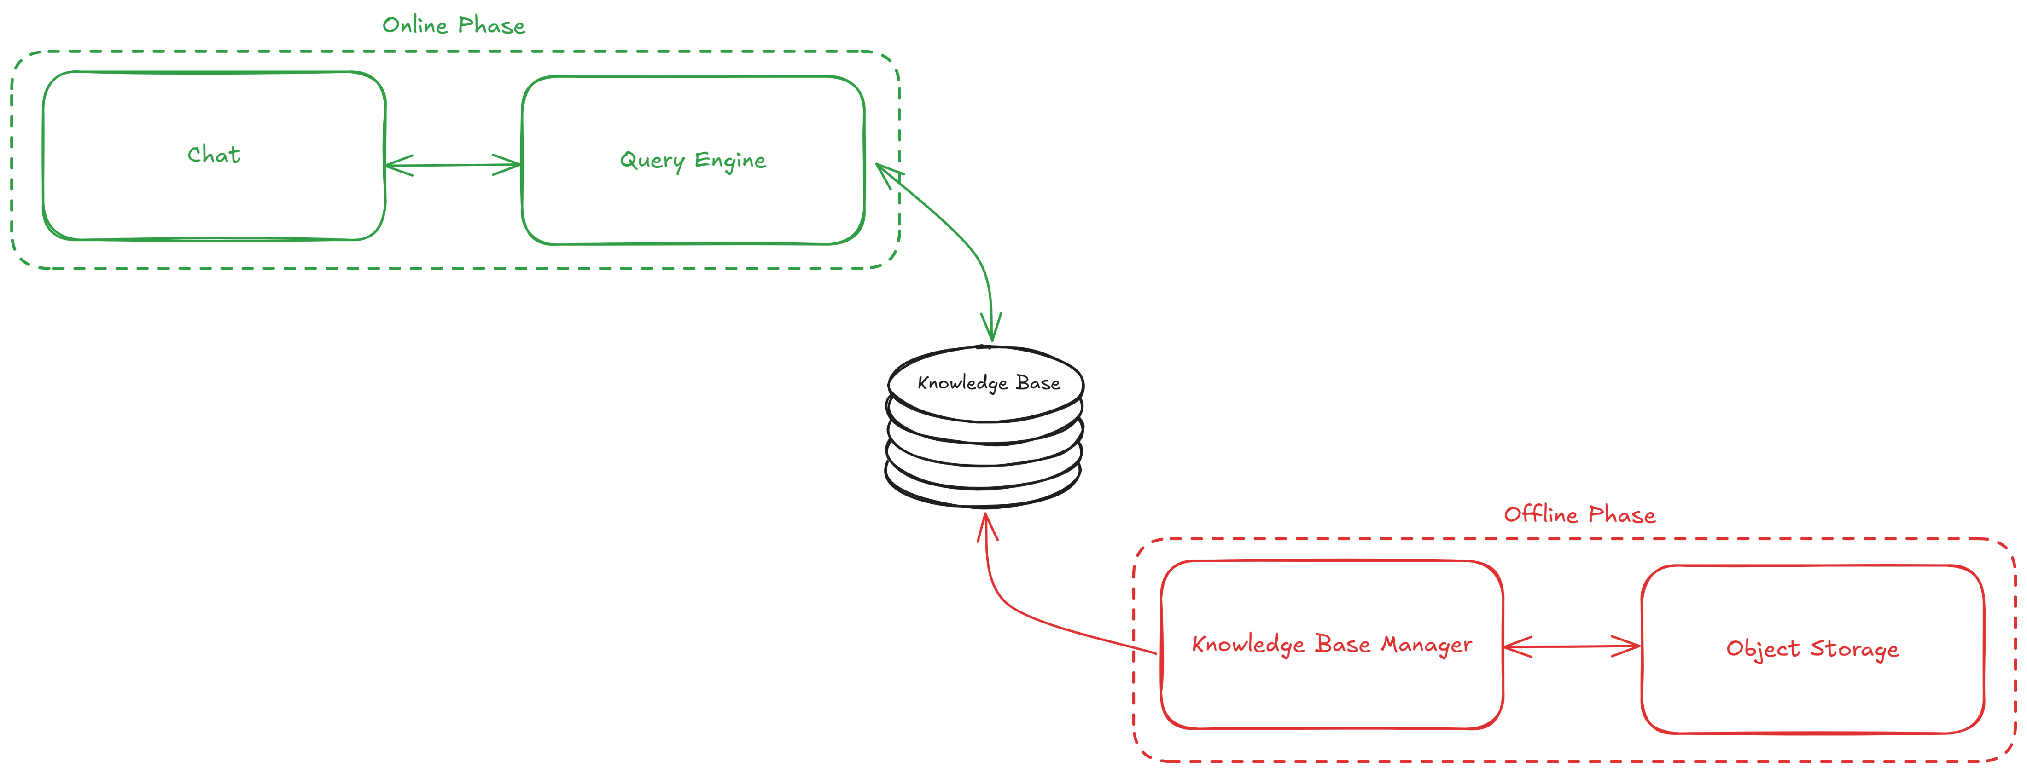
Solution Description – High Level Architecture

Slide 6
Solution Description – Offline Phase (1/2)
Goal: creating the Knowledge Base.
Description: the Knowledge Base Manager (i) reads menus and supporting documents (e.g., cooking manual, intergalactic code of conduct, dish mappings, planets distances, …) from an object storage, (ii) generates for each dish a JSON descriptor that represents it, (iii) and saves it in a document database.
Notes: in this exemplified setting both the object storage and the document database are folders in our repo, but the switch to acutal tools such as MinIO and MongoDB, for instance, is simple.

Slide 7
Solution Description – Offline Phase (2/2)
Data Model: for each dish, we create a descriptor with the following information.
Restaurant
Name
Planet
Chef
Name
Licenses (Name, Code, Level)
Dish
Code
Name
Ingredients
Techniques (Name, Category, Subcategory)
Orders Info
Andromeda Info
Armonisti Info
Naturalisti Info

Slide 8
Solution Description – Online Phase (1/2)
Goal: querying the Knowledge Base.
Description: the Query Engine (i) receives a question from the user, (ii) “understands” it, (iii) and transforms it in a sequence of filters to apply on the Knowledge Base so to extract the dishes that respect the question’s constraints.
Notes: in this exemplified setting we made some assumptions about the types of questions the system can handle. Nevertheless, with some work, one can make the whole process more general and robust.

Slide 9
Solution Description – Online Phase (2/2)
Question Understanding: each question is processed to produce a descriptor that strictly parallel that of a dish by applying the following steps.
Extract ingredients and techniques (LLM-Based).
Extract restaurant and planet (Rule-Based).
Extract licenses (LLM-Based).
Extract orders (Rule-Based).
Question Execution: the content of the Knowledge Base is recursively filtered based on the question descriptor extracted in the previous step to produce a list of suitable dishes.

Slide 10
Solution Description – Results & Improvements
The results are promising, considering the limited resources we relied upon. In particular, we obtained a 72.5 score with our best submission using the approach described in this presentation.
Here’s some potential improvements:
Refine the question understanding and execution mechanisms to produce more accurate questions representations and more reliable sequences of action.
Use a more powerful model to answer the question by passing it to a more powerful model with the whole Knowledge Base and leveraging the Data Model.

